Slide 1
Static FPGA Programming using Flash ROM
Eng. Amr Alaa
Prof. Mohamed Abd El-Ghany

Slide 2
FPGA Programming Methods
JTAG Programming.
USB Programming. “Normal”
Queued Serial Peripheral Interface (QSPI) Flash ROM.

Slide 3
QSPI Flash ROM Programming
A .BIN (binary) file is generated from the bitstream.
The .BIN file is then stored on the flash ROM from the PC.
Afterwards, the FPGA can be programmed from the flash ROM using the prog button.
The binary data is preserved even without power.

Slide 4
QSPI Flash ROM Programming
The Basys-3 FPGA board can have a ROM from either of the following manufacturers:
Spansion
Macronix

Slide 5
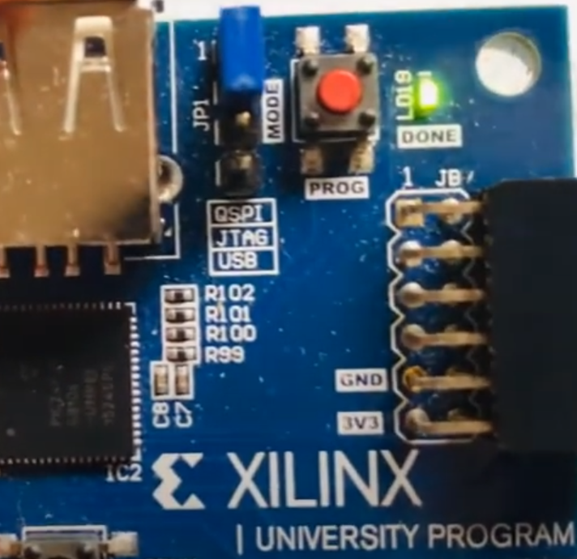
QSPI Flash ROM Programming Steps
Set the JP1 jacket (blue) to QSPI (top pin to the left of the prog button) as follows:

Slide 6
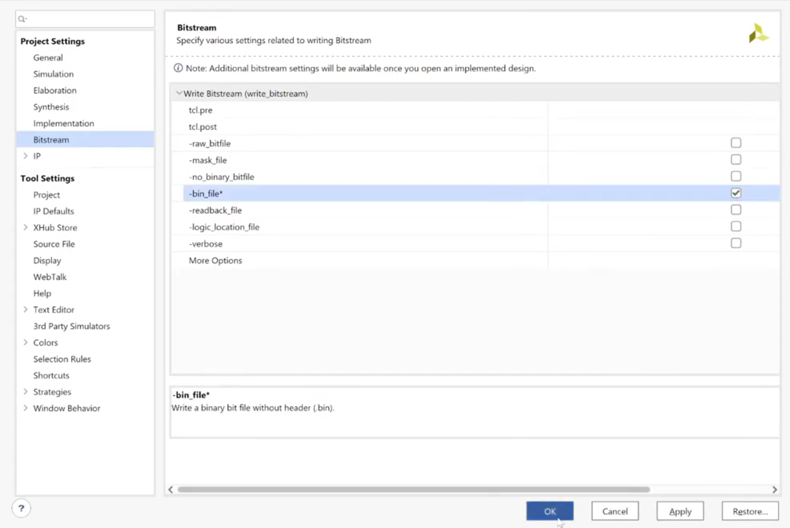
QSPI Flash ROM Programming Steps
In Vivado, click on Project Settings > Bitstream, then enable bin_file:

Slide 7
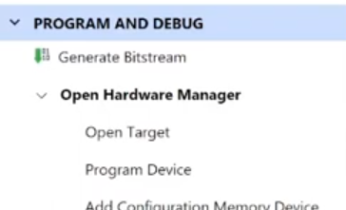
QSPI Flash ROM Programming Steps
Generate the bitstream as you would normally, then connect your FPGA board and launch the hardware manager.
From the left sidebar, under the hardware manager section, select “Add Configuration Memory Device”

Slide 8
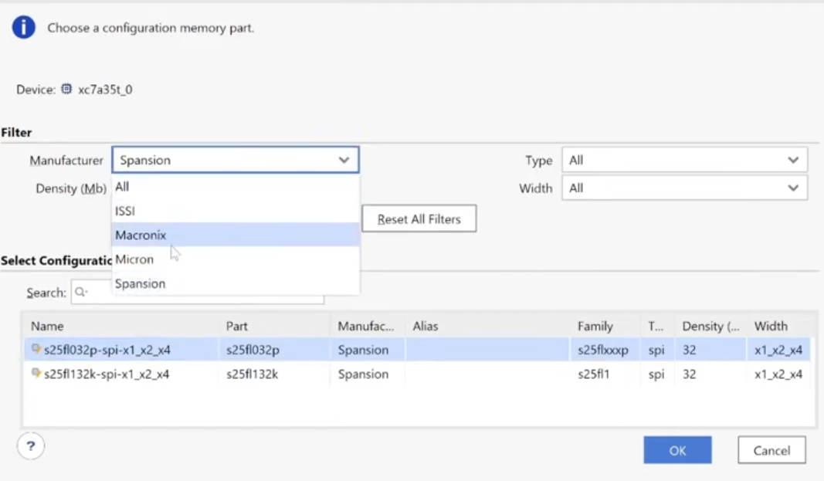
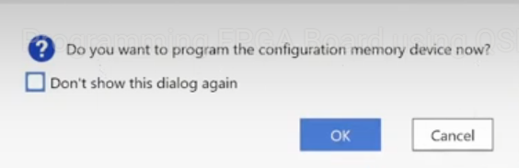
QSPI Flash ROM Programming Steps
Select the manufacturer, either Spansion or Macronix for the Basys-3 (if you select the wrong one, an error will inform you of such and you can simply select the other. Finally, choose “OK” to program the configuration memory device.

Slide 9
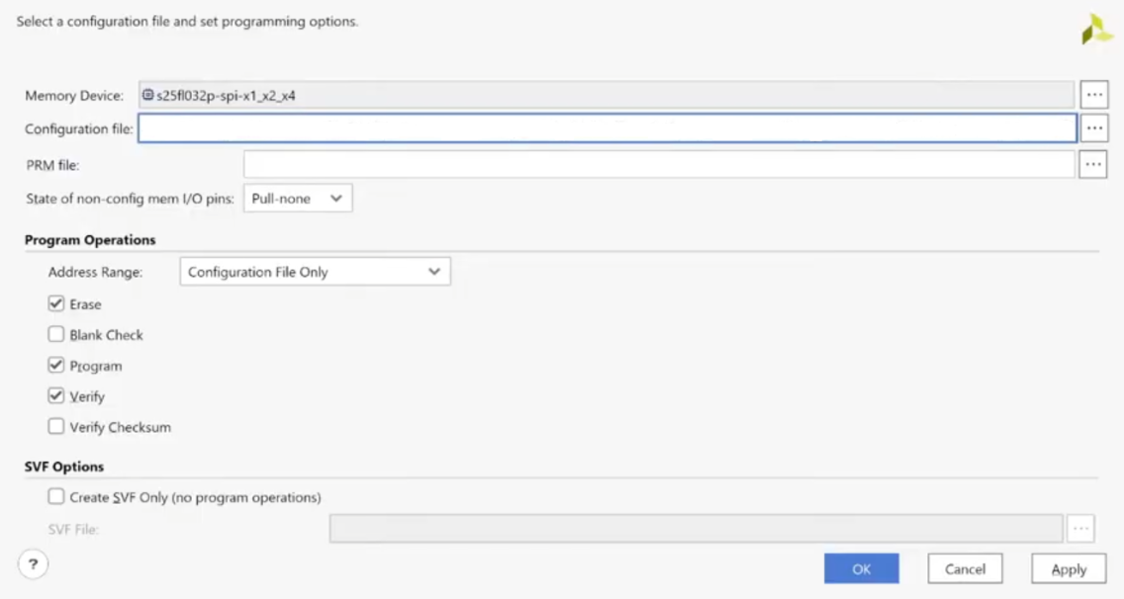
QSPI Flash ROM Programming Steps
Click on the three dots next to the configuration file field to select the generated .BIN file (make sure to choose “All Files” in the Files of type dropdown menu). Finally, check “Erase,” “Program,” and “Verify.”

Slide 10
QSPI Flash ROM Programming Steps
Now the binary file should be stored onto the FPGA, in order to program it you should follow these steps:
Turn off the FPGA’s power from the power switch.
Wait for a few seconds.
Switch the power back on.
Finally, press down the program (red) button for a few seconds (1-2s).
If successful, the “DONE” LED next to the program button should turn on.

